Slide 1

Cloud Extreme
The Cloud Challenge
Motivation for Microservices
Jürgen Heymann

Slide 2
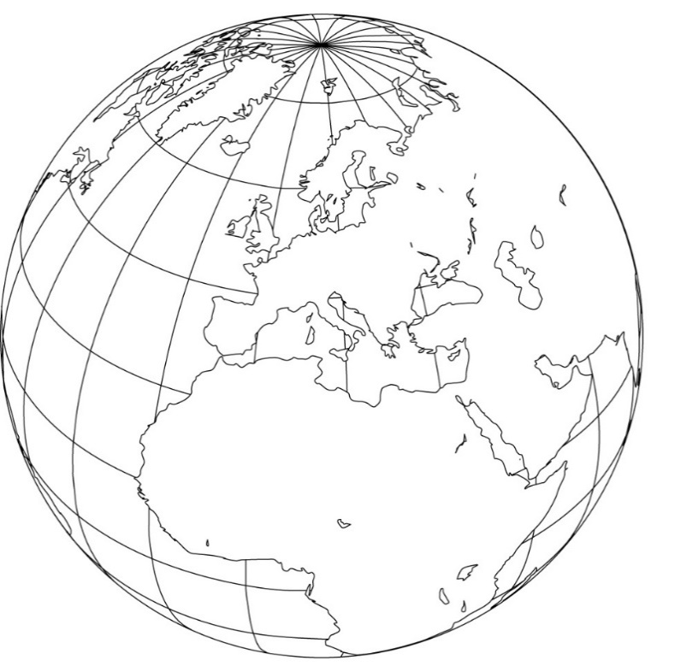


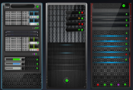

Cloud Deployment Models – Terminology
Public Cloud – ALL Customers
Public Cloud
On-Premise (@customer)
Private Cloud (@customer | SAP)
HANA Enterprise Cloud (@SAP)
Hybrid Cloud
1 customer – 1 system landscape

Slide 3
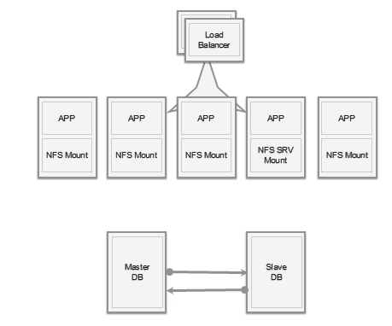
SAP's Traditional Development and Deployment Model
SAP systems are one logical system with single DB
Data consistency guaranteed by transactions of DB
Scaling with single DB sufficient for most customers
Problems
Vertical Scaling (= 'more expensive servers‘) is limited, cost is non-linear
Systems poorly utilized (dev-test, non-peak-times)
High Availability Setup requires almost doubling the infrastructure

Slide 4

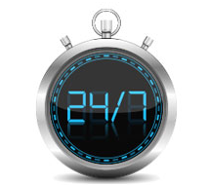
Key Challenges of a Public Cloud Application
Boundless Scalability: millions of users, thousands of servers, petabytes of data, globally distributed
Seamless failover (uptime > 99.99%) in spite of hardware and software failures
Zero Downtime Deployments for all parts, all the time (there is no 'planned downtime'!)
Notes:
data center: Google
disk picture: from Google Data Centers
24/7: http://www.couchbase.com/sites/default/files/uploads/all/images/zero_down_time.jpg

Slide 5
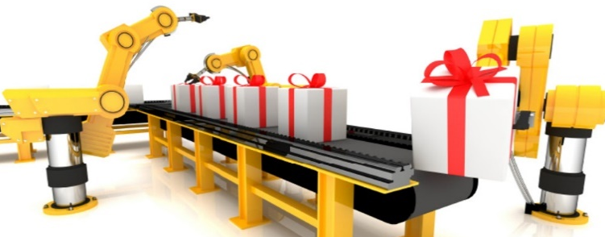
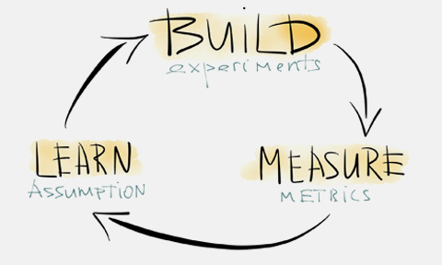
Key Challenges of a Public Cloud Application
Must be able to ship any kind of change within a day
All tests and deployment fully automated, operations partly automated
Develop in short cycles, enable fast innovation and use of feedback
Notes:
build measure learn: http://evolveyourweddingbusiness.com/wp-content/uploads/2013/01/buildmeasurelearn.jpg
automated deployment: https://sebastian-bergmann.de/img/thumbnails/efb37e604174144b322c45f8e9c96e492906b347.jpg

Slide 6

How write applications for this context? Microservices, 12-Factor Apps, Design, …
Notes:
picture: http://dpr-1448.kxcdn.com/assets/project-media/computer_room_1_WEBSITE_960_x_360.jpg

Slide 7
Microservices
"Microservice architecture is an approach to developing a single application as a suite of small services, each running in its own process and communicating with lightweight mechanisms, often an HTTP REST API. These services are built around business capabilities and independently deployable by fully automated deployment machinery. " (source)
application
web app
catalog
review
mobile apps
recommendation
order
Notes:
Definition of microservices, see Source: http://martinfowler.com/articles/microservices.html

Slide 8
Monolith versus Microservices
process
A
A
A
B
A
B
A
B
services
C
D
C
D
A
C
B
D
Microservices are separate processes, this is key to scale services independently
Microservices can use caches better and are easier to manage globally

Slide 9
Key Aspects of Microservices
Scalable & Elastic
Microservices scale horizontally by adding more processes
Linear scaling → no bottleneck from database → partition data (aka 'sharding') and/or reduce to 'eventual consistency'
Elastic = autoscale to strongly varying loads
Service instance fails → 'health monitor' creates a new one
Service fails → application remains up when non-core service is down
Hardware failures → not noticed by users at all
Deploy small changes fast and frequently
Compare to a big release: less risk per deploy
Simpler to do a zero-downtime upgrade
Resilient
Deployable independently

Slide 10
Key Aspects of Microservices
You can use technologies & languages that best fit the problem
using the right tools has large impact on productivity and performance
in a monolith it is almost impossible to adopt new stacks / technologies
microservice
Posts
Pictures
Business
Analytics
language
node
node
java
Document Store
Blob Store
SQL
HANA / …
backing service
replication
Notes:
Definition of microservices, see Source: http://martinfowler.com/articles/microservices.html
Architectural style
Approach to developing a single application as a suite of small services
Each service running in its own process and communicating with lightweight mechanisms, often an HTTP resource API
Services are built around business capabilities
Independently deployable by fully automated deployment machinery
There is a bare minimum of centralized management of these services, which may be written in different programming languages and use different data storage technologies
All cloud providers do not use microservices, e.g. facebook has a monolith structure. However, than you need to find other ways to solve typical issues / get the desired qualities.

Slide 11
Key Aspects of Microservices
Process boundary drives high cohesion and low coupling
It is clear what the public API and the contract is
Easier to test fully
Unit tests for inside algorithms and service level tests for public interface
Smaller code-base, easier to work with
Microservice is usually owned by one team

Slide 12
Some drawbacks
Communication overhead between microservices (HTTP, REST / JSON)
Asynchronous communication, more complex programming model
Distributed systems programming is more complex
Higher memory consumption (depends on stack!)
No global transactions, instead: 'eventual consistency'
Dependencies must be managed: Versioning of interfaces
Features covering multiple microservices still need rollout sync
BUT: These concepts – whether implemented as microservices or otherwise – are the only way to reach the scale needed for large cloud systems.

Slide 13
How write applications for this context? Microservices, 12-Factor Apps, Design, …
Notes:
picture: http://dpr-1448.kxcdn.com/assets/project-media/computer_room_1_WEBSITE_960_x_360.jpg

Slide 14

12 Factors: Rules for Cloud Product Development (http://12factor.net )
1) Codebase – all under version control All code, scripts, config, install … in version control
2) Dependencies Explicitly declare all dependencies (manifest); no assumptions on installed tools & context
3) Configuration App deploy config stored separate from code and exposed via environment
4) Backing Services Treat datastores, messaging, .. services as attached resources. No distinction between local and third-party services (e.g. twitter)
5) Build, release, run
6) Processes Execute the app as 1-n stateless share-nothing processes
7) Port binding
8) Concurrency / Scalability Scale out horizontally via the process model (not threads)
9) Disposability Maximize robustness with fast startup and shutdown
10) Dev/Prod parity Keep dev and prod as similar as possible
11) Logs Logs treated as event streams to stdout
12) Admin processes
Provided / supported by Cloud Foundry

Slide 15
How write applications for this context? Microservices, 12-Factor Apps, Design, …

Slide 16
Microservices – Design Aspects
Goal: Microservices do not share databases, no joins in DB
Many cloud apps started as monoliths with pieces extracted to microservices over time as needed for scalability
When developing a new app, start with a larger microservice until the logical boundaries have stabilized, then extract.
Design microservices using the Bounded Context design method and following the Single-Responsibility-Principle in design
Driver of transition to microservices is scalability, uptime >99% and developer productivity.

Slide 17
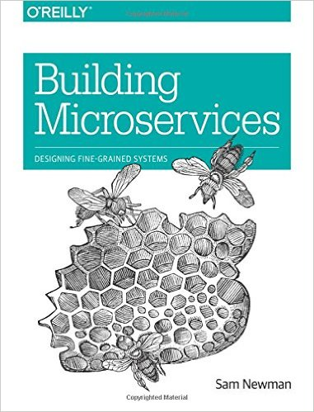
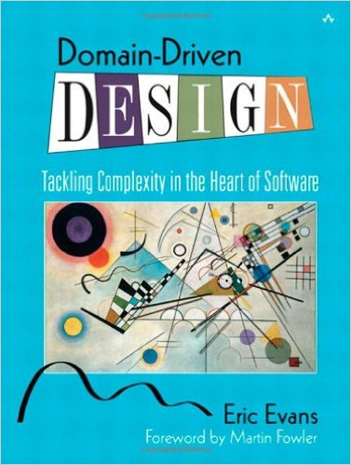
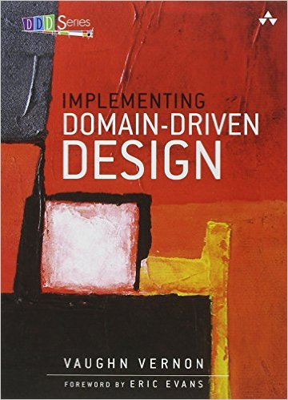
Further Reading
References
The classic Microservice article by Martin Fowler
Microservice Architecture pattern
Microservices for scalability
Microservices in a Nutshell: Pros and Cons
Bounded Context Design (Fowler)
Recommended Reading

Slide 18
More pictures

Slide 19
Large ecommerce example
Router
All services
scale independently and automatically
use custom tools and separate DB
offer REST and/or html output
are deployed & replicated globally
user mgt
Landing Page
static content
…
Product discovery
Product presentation
Checkout
Fulfillment
search
product info
media
Cart
wishlist
order mgt
stock
recommen-dations
pricing & discounts
order creation
payment
invoicing

